Slide 1
Markov & Gaussian Localization Chapter 7

Slide 2
Autonomous mobile robots
autonomy
Vehicle
Actuators
Vehicle model
Sensors
Control
Vehicle autonomy
Path & motion planning
Localization
Perception
Independent from user
Localization & mapping
Independent from environment

Slide 3
Mobile robot localization
In robot localization it is given a map of the environment and its goal is to determine its position relative to this map given the perceptions of the environment & its movements.

Slide 4
Mobile robot localization
Mobile robot localization can be seen as a transformation problem between the robot’s local coordinate frame and the global coordinate frame.
Most robot do not possess a sensor for measuring pose directly from a single scan.
It has to integrate data over time to determine its pose.
Localization problems assume that an accurate map is available.

Slide 5
Examples of maps
Metric
Topological
Occupancy grid
Mosaic of a ceiling

Slide 6
A taxonomy for localization
- Local
- Global
- Kidnapped
Single
Multi-robots
LOCALIZATION
Passive
Active
Static
Dynamic

Slide 7
Local verses global localization
Here localization is characterized by the type of knowledge that is available initially & at run-time.
Three types of localization problem:
Position tracking: initial position known, localization is achieved by modeling noise in robot motion.
Global localization: initial pose is unknown. Solutions can not assume boundedness of the pose error. More difficult than position tracking.

Slide 8
Local verses global localization
Kidnapped robot: a variant of global localization, but where the robot can get kidnapped and tele-operated to some other location during operation.
The kidnapped robot problem is more difficult than global localization, in that the robot might believe it knows where it is while it does not.
In global localization the robot knows that it does not know its location.
Testing a localization algorithm by kidnapping it measures its ability to recover from global failures.

Slide 9
Static verses dynamic environments
Static environments: here the only variable quantity is the robot’s pose. All other objects in the environment remain the same.
Dynamic environments: here other quantities vary in time. Examples include moving people, movable furniture.
Localization is more difficult in dynamic environments.
Two approaches: (1) include dynamic objects in state. (2) filter sensor data to eliminate effect of un-modeled dynamics.

Slide 10
Passive vs. active approaches
Passive: localization module only observes the robot operating. Robot is controlled by other means (maybe randomly)
Active: such algorithms control the robot to so as to minimize the localization error and the costs arising from moving a poorly localized robot into a hazardous place.
Active methods achieve better results than passive methods.

Slide 11
Active vs. passive techniques

Slide 12
Single robot vs. multi robots
Single robots: most common type, here all data is collected to a single platform.
Multi-robot localization: here robot can either work on their own or communicate with each other to better the localization of all.
In multi-robot localization, one robot’s belief can be used to bias another robot’s belief if relative pose of the robots is known.

Slide 13
Markov Localization
Probabilistic localization algorithms are variants of the Bayes filter.
The straightforward application of the Bayes filter to the localization problem is called the Markov localization.
Requires a map m as input
The map plays a role in the measurement model
It is often incorporated in the motion model
Markov localization can be used for position tracking, global localization, and kidnapped robot problems.

Slide 14
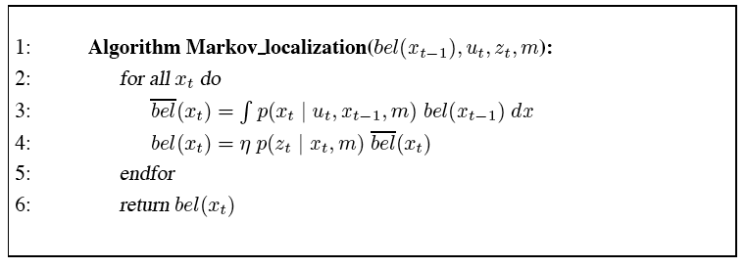
Markov localization
Markov localization transforms a probabilistic belief at time t-1 to a belief at time t
The initial belief, bel(x₀) reflects the initial knowledge of the robot’s pose. This is different according to type of localization

Slide 15
How bel(x₀) is set
Position tracking. If the initial pose is known, bel(x₀) is initialized by a point-mass distribution.
initial pose
In practice the initial pose is known only to approximation. The belief is initialized by a narrow Gaussian distribution.

Slide 16
How to initialize for global localization
If the initial position is unknown, bel(x₀) is initialized by a uniform distribution over the space of all legal poses in the map.
volume of the space of all poses within the map

Slide 17
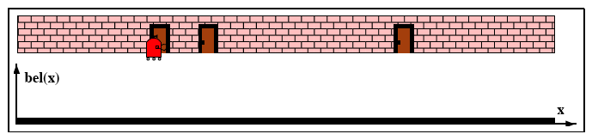
Illustration of Markov localization
Initial belief is uniform over all poses.
As the robot queries its sensors it notices that it is adjacent to one of the doors.
It multiplies its belief bel(x₀) by p(z_{t} | x_{t}, m)

Slide 18
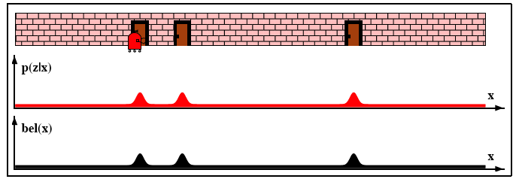
Illustration of Markov localization
The lower density bel(x) is the result of multiplying this upper density into the uniform prior belief.
The result is multi-modal indicating that the robot could be one of three places facing a door.

Slide 19
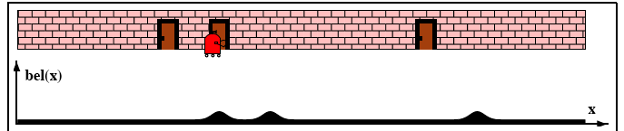
Illustration of Markov localization
As the robot moves right, the belief is convolved with the motion model p(x_{t} | u_{t}, x_{t-1})
The result is a shifted belief that is flattened out, as a result of the convolution.

Slide 20
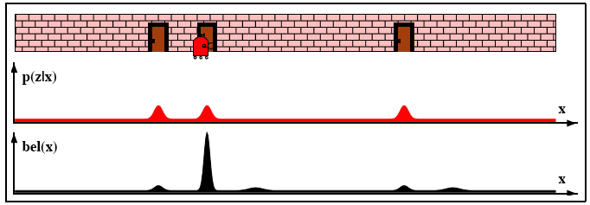
Illustration of Markov localization
In the final measurement, the Markov localization algorithm multiplies the current belief with the perceptual probability p(z_{t}| x_{t})

Slide 21
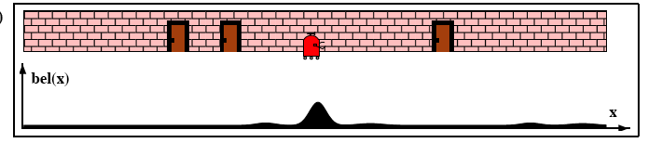
Illustration of Markov localization
Next as the robot navigates the belief moves with it, although it decreases due to the accumulated error.

Slide 22
EKF localization
The Extended Kalman Filter (EKF) localization is a special case of Markov localization.
With EKF localization beliefs bel(x_{t}) are represented by their mean μ and covariance Σ_{t}.
In EKF localization, the map is represented by a collection of features.
At any point in time t, the robot observes a vector of ranges and bearings to nearby features

Slide 23
EKF localization
We will assume the identity of a feature is expressed by a set of correspondence variables c_{t}^{i}, one for each feature vector z^{i}_{t}

Slide 24
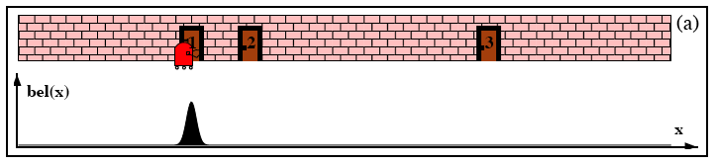
EKF localization
In this first example we assume we have perfect correspondences and the doors are labeled (1, 2, and 3)
We will denote the measurement model as p(z_{t}|x_{t}, m, c_{t}), where c_{t} is either {1,2,3}.

Slide 25
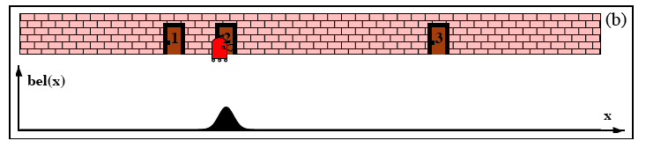
EKF localization
As the robot moves to the right, its belief is convolved with the Gaussian motion model.
The resulting belief is a shifted Gaussian of increased width.

Slide 26
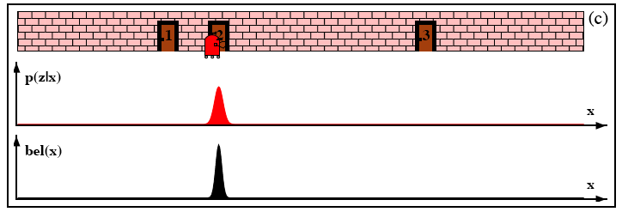
EKF localization
The upper density visualizes p(z_{t} | x_{t}, m, c_{t})
Folding this measurement probability into the robot’s belief yields the posterior shown on the bottom graph.

Slide 27
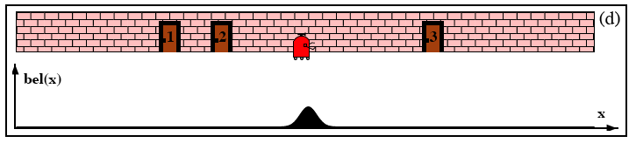
EKF localization
As the robot moves down the corridor, the robot’s uncertainty in its position increases since the EKF continues to incorporate motion uncertainty into the robot’s belief.

Slide 28
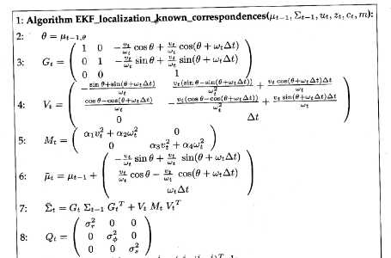
EKF localization (known correspondence)
Jacobians of the motion model
predicted pose after motion
corresponding uncertainty in state space

Slide 29
Mathematical derivation
time window over which motion is executed
Using the motion model of (5.13):
At time t
At time t-1
The control input

Slide 30
Mathematical derivation
We can also decompose this last equation into a noise-free component and a random noise component
At time t
g(u_{t},x_{t-1})

Slide 31
Mathematical derivation
The EKF approximates g(u_{t},x_{t-1}) as follows:
And G_{t} is the Jacobian of g with respect to u_{t} and μ_{t-1}.

Slide 32
Mathematical derivation
Calculating all these derivatives:

Slide 33
Noise in control space
The Covariance matrix of the noise in control space is expressed as:
Transformation from control space to state space is done via a Jacobian V_{t}, which is the derivative of the motion function g with respect to the motion parameters u_{t} and μ_{t-1}

Slide 34
Calculating V_{t}

Slide 35
EKF localization (known correspondence)
Jacobians of the motion model
predicted pose after motion
corresponding uncertainty in state space

Slide 36
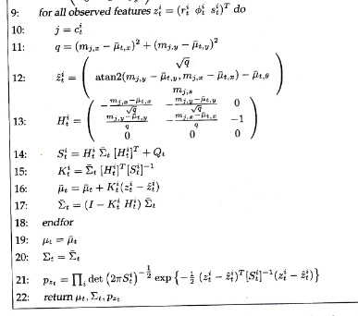
EKF localization algorithm
Assign to j the correspondence of the i^{th} feature in the measurement vector
Calculates a predicted measurement
Jacobian of the measurement model
Uncertainty of measurement
Kalman gain is computed for each observed feature
Estimate is updated
New pose estimate
Measurement likelihood

Slide 37
Linearized measurement model
Let us denote by j the identity of the landmark that corresponds to the i-th component in the measurement vector:

Slide 38
Linearized measurement model
We can re-write this last equation as:

Slide 39
Linearized measurement model
The Taylor series approximation allows us to write:

Slide 40
Linearized measurement model
Calculating the derivatives we get lines 7-11

Slide 41
Independence assumption
We assume that all feature measurement probabilities are independent given the pose x_{t} and the map m:
This assumption is good in static environments
Allows inclusion of multiple features into our filter.

Slide 42
Physical implementation

Slide 43
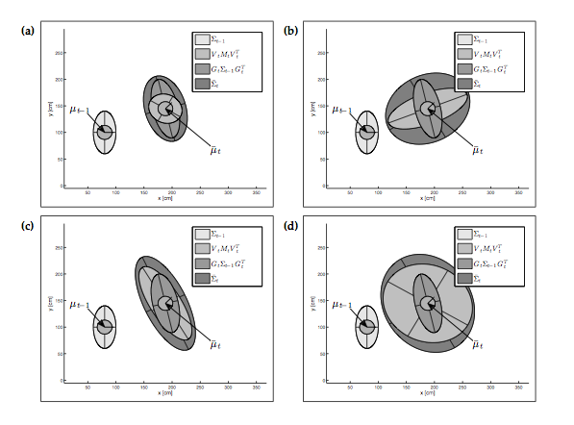
Prediction step
u_{t}=10cm/s;5º/s for 9 seconds
result: Arc leng=90cm & Rot = 45º
α₁=10%;
α₄=10%
α₁=30%;
α₄=10%
α₁=10%;
α₄=30%
α₁=30%;
α₄=30%

Slide 44
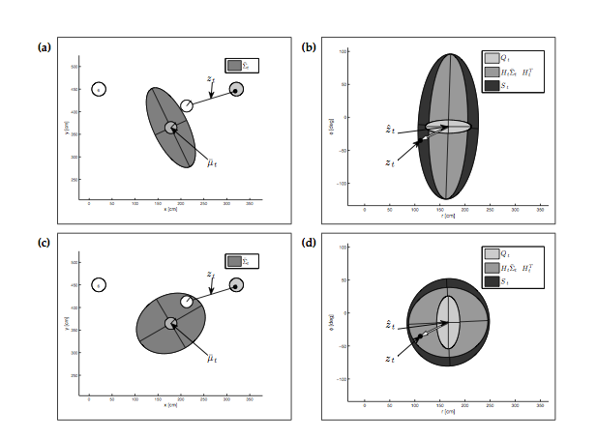
Measurement prediction

Slide 45
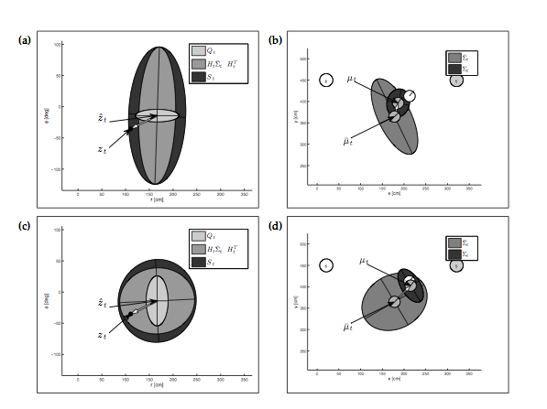
Correction step

Slide 46
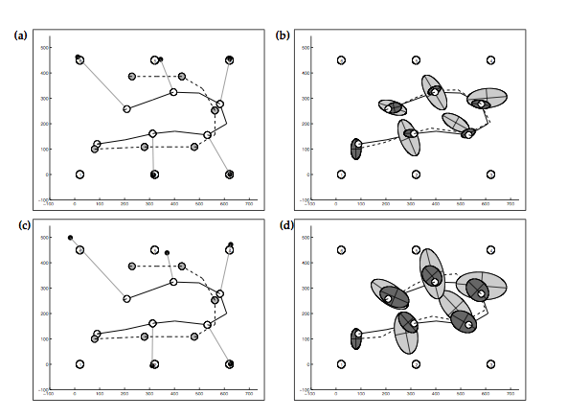
EKF-based localization

Slide 47
EKF localization with unknown correspondences
The most simple way to deal with this is Maximum Likelihood (ML)
One first determines the most likely value of the correspondence value, then takes it for granted.
ML techniques are brittle if there are many equally likely hypotheses for the correspondence variable.

Slide 48
How to deal with false correspondences
Select landmarks that are sufficiently unique and sufficiently far apart from each other.
Make sure that the robot’s pose uncertainty remains small.
These strategies are counter to each other. So finding the right granularity of landmarks can be somewhat of an art form.
The ML technique is of great practical importance.
In the table below the correspondence variable is chosen by minimizing a Mahalanobis distance.

Slide 49
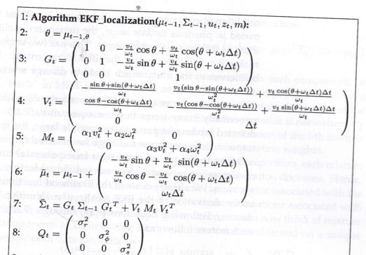
EKF localization (unknown correspondence)

Slide 50
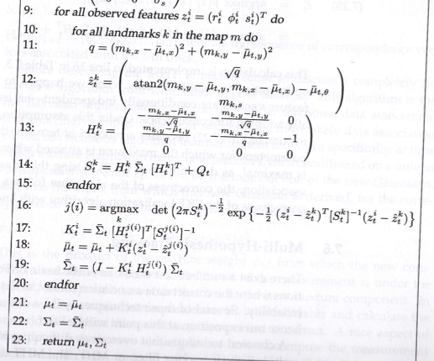
EKF localization (unknown correspondence)

Slide 51
Multi-hypothesis tracking
The Multi Hypothesis Tracking (MHT) represents a belief by a mixture of Gaussians:
Here each component (track) is a Gaussian with mean μ_{t,l} and covariance Σ_{t,l}. The scalar Ψ_{t,l} > 0 is a mixture weight.

Slide 52
MHT data association
Each mixture component relies on a unique sequence of data association decisions.
Therefore we write the data association for each track l as c_{1:t,l}
We can now write:

Slide 53
MHT
The MHT terminates each component whose relative mixture weight is smaller than a threshold:

Slide 54
Limitations
EKF and MHT tend to work well only if the position uncertainty is small.
A uni-modal Gaussian is usually a good representation of uncertainty in tracking. It is not a good representation in global localization problems.
A narrow Gaussian reduces the danger of erroneous correspondence decisions. A single false correspondence can derail the tracker. The MHT is more robust to this problem, although it can fail if the correct correspondence is not amongst those in the GMM

Slide 55
Limitations
The Taylor expansion is usually only good in close proximity to the linearization point.
As a rule of thumb, if the STD for the orientation is larger than ±20 degrees, linearization will make the system fail.
The Gaussian localization algorithms are inapplicable to global localization problems or the kidnapped robot problem.

Slide 56
Important points
The design of the appropriate features for the EKF localization is an art.
On one hand we want multiple features to keep the uncertainty low.
On the other hand we want to minimize the chance that landmarks are confused with each other.
Here MHT is more robust.
As a rule of thumb, a large number of landmarks work better than small numbers.
It is however critical to apply mutual exclusion principle in data association

Slide 57
Important points
EKF localization is unable to process negative information (absence of features).
EKF simply ignores the issue of negative information.
IN SPITE OF ALL THESE LIMITATIONS, EKF LOCALIZATION CAN BE EXCELLENT IF WE ADDRESS THE ISSUE OF CORRESPONDENCE.

